Slide 1

Data structure and algorithm
By: Chandana MN
20030141cse-060
Divyashree.A.S.
200230141cse065
Bandi rupa sravya
Prov/btech-cse/le-21/002
Rakshitha b
Prov/btech-cse/le-21/006
ASSIGNED BY- Dr. Saswati Debnath mam

Slide 2

phone directory management using C

Slide 3

phone directory
A phone directory is commonly called as telephone book, telephone address book, phone book.
Its purpose is to allow the telephone number of a subscriber identified by name and address to be found.
Phone Directory is a directory , In that we can easily store the number and easily access when we needed.

Slide 4
header files used in our program
1. #include<stdio.h> : this header file will contain Scanf() , Printf (),and many more…..
2. #include<conio.h>: this header file will contain Clrscr(); , Getch(); , and many more…..
3 . #include<string.h> : this header file will contain string function such as
1.Strrev();
2.Strlen();
3.Strupr();
4.Strlwr();
And many mores……

Slide 5
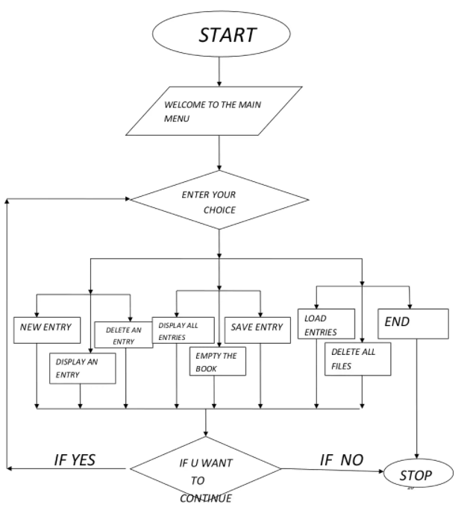
Flow chart

Slide 6
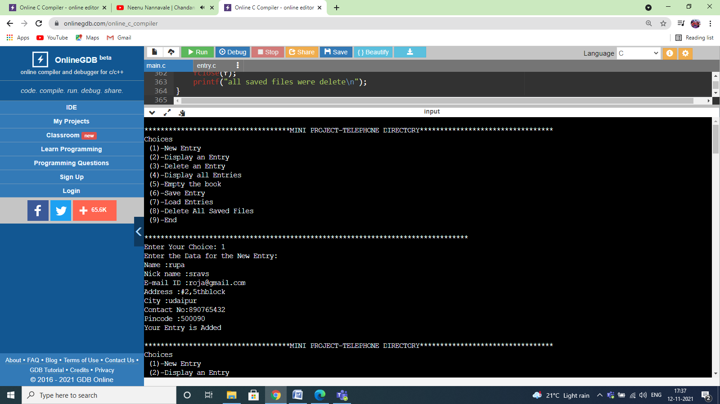
Output of our project

Slide 7


Slide 8


Slide 9


Slide 10
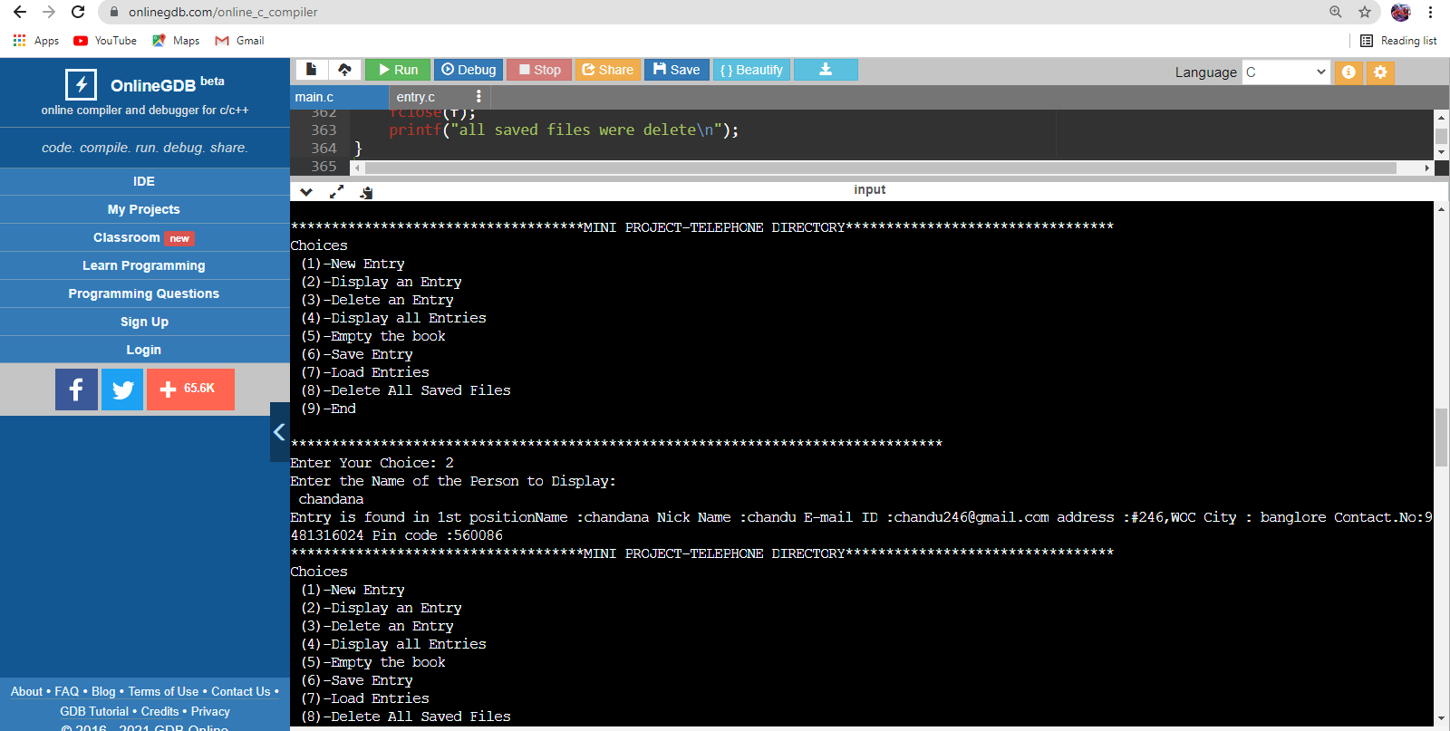

Slide 11


Slide 12


Slide 13


Slide 14


Slide 15
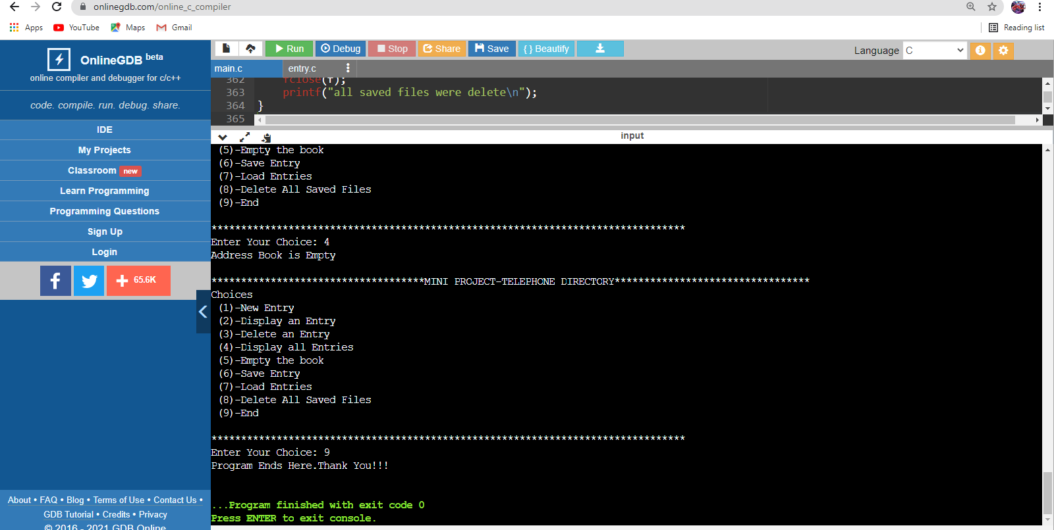

Slide 16

references
https://www.google.com/search?q=phone+directory+managment&oq=phone+directory+managment&aqs=chrome..69i57j0i10i22i30.30574j0j15&sourceid=chrome&ie=UTF-8
https://itsourcecode.com/free-projects/c-projects/phone-book-management-system-in-c-with-source-code/
https://www.geeksforgeeks.org/implement-a-phone-directory/
https://www.freeprojectz.com/free-android-project-source-code-download/telephone-directory-management-system

Slide 17


